Slide 1
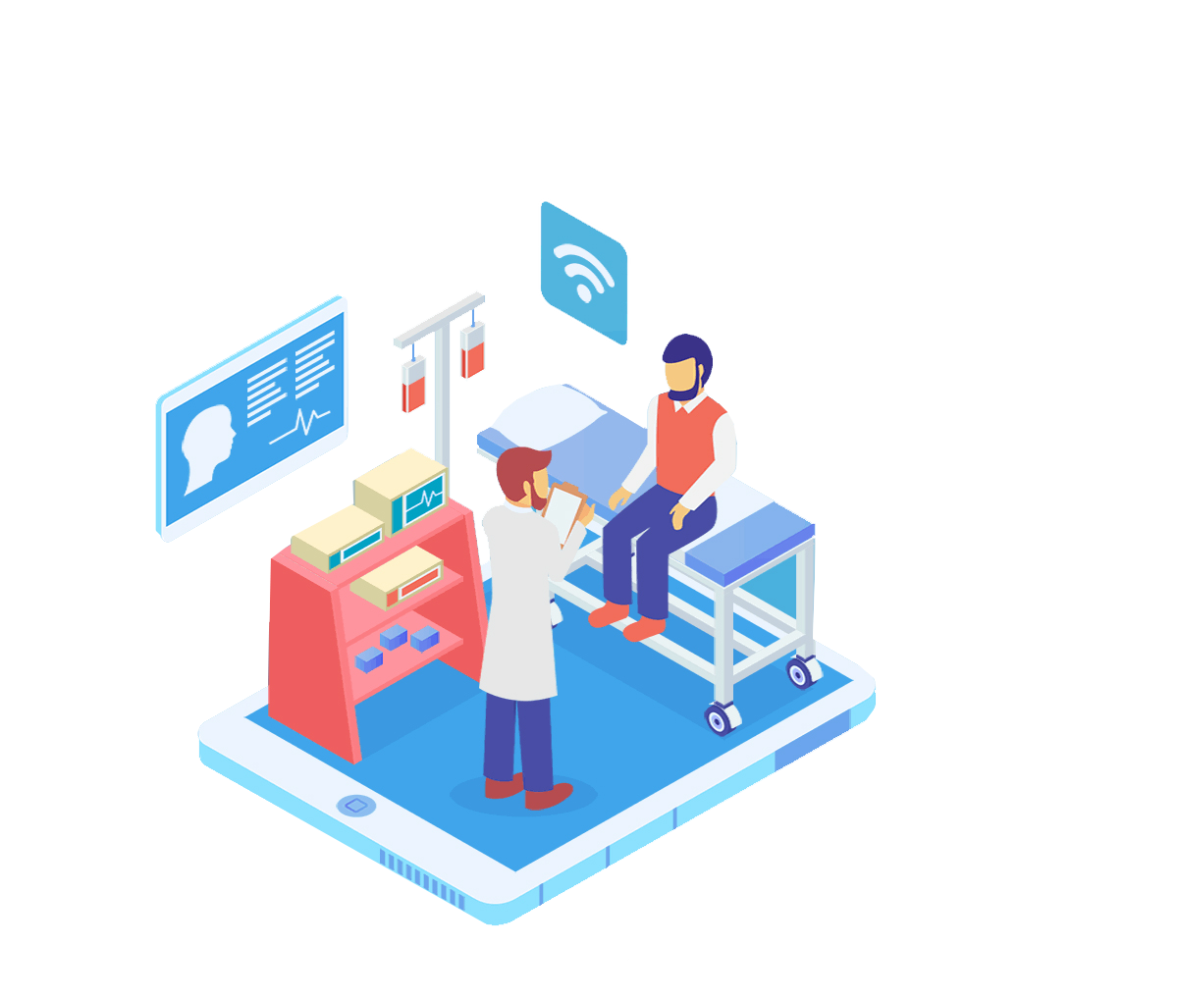

SMART HEALTH CARE
TEAM NO : 62
TEAM MEMBERS : VIGNESH R, VARSHA,VARSHINI, VISHAAL, VISWANATHAN, YOGARAJAN,YOGIRAAJ, YOHAN
MENTOR : SHERLIN MICHAEL

Slide 2
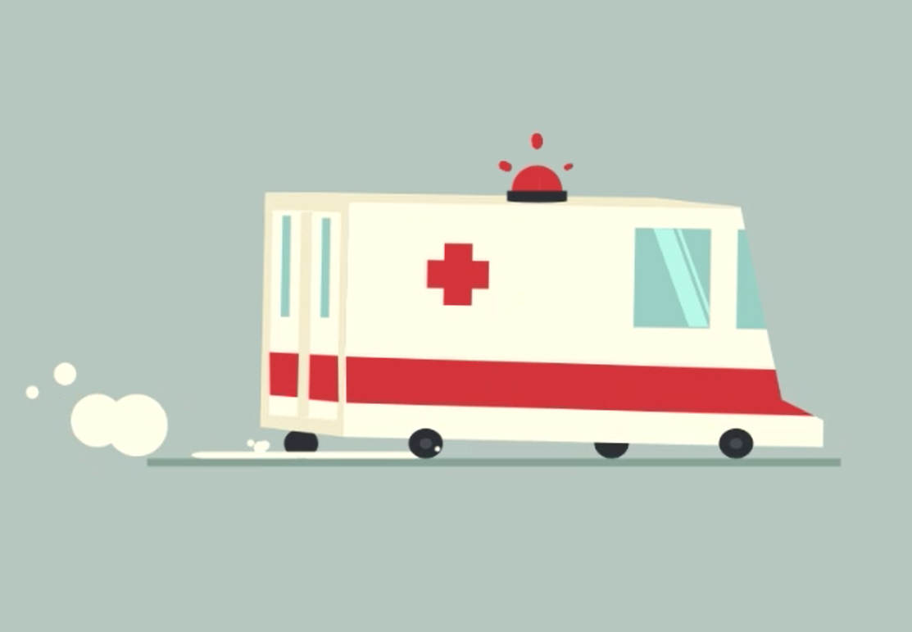
THE PROBLEM
Everyday, lives are lost because medical care and services are inaccessible to people in need.
In cases where the patient was alone the patient may have been in too much pain or immobilized and calling for assistance is not an easy task.
In most of these cases medical assistance could have saved the person.

Slide 3
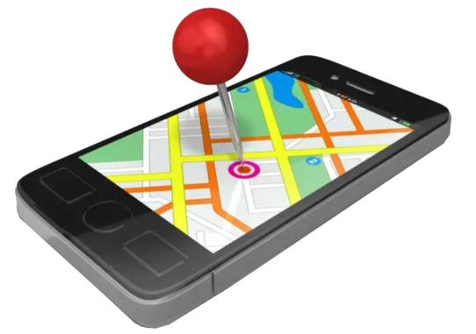
IDEA
To create a smart wearable device (panic button) for a conscious patient in a medical emergency.
To make the process of requesting medical assistance easier and faster.
To save time in a medical emergency by reducing the number of steps involved in requesting for aid.

Slide 4
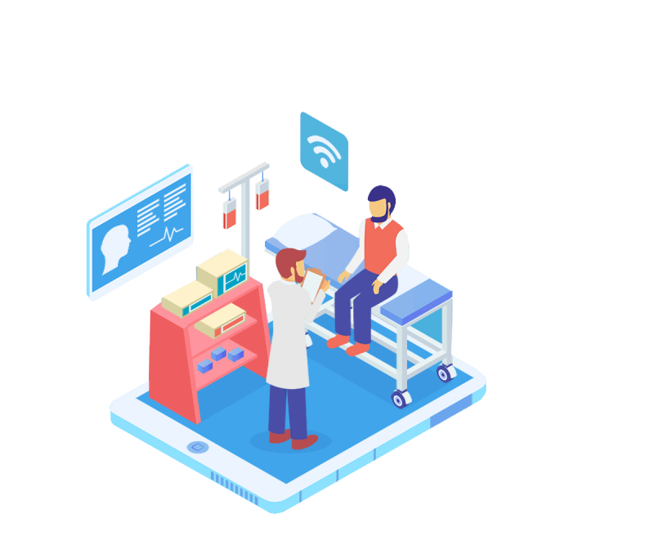
WHY CHOOSE OUR PRODUCT
Faster than conventional methods of communication for sending a distress signal.
This eliminates the inconvenience of having to do too many steps while in a potentially dangerous situation.
It is fast and relatively inexpensive to implement this system in partnership with hospitals.
Quick medical assistance can be dispatched and this could save hundreds of lives.

Slide 5
HOW IT WORKS
The patient in distress pushes the panic button.
An emergency distress message along with the device’s GPS location is sent to the nearest hospitals servers.
Prerequisite:
We (product designers) partner with hospitals to give you (the users) our smart healthcare product. The hospitals maintain servers to which the distress message and GPS location is sent. These servers are monitored and maintained by the hospitals and help is dispatched when called for.
The hospital dispatches emergency vehicles and responders and the patient is located.
The patients condition is assessed and based on the severity he/she is either taken to the hospital or first aid is administered.

Slide 6
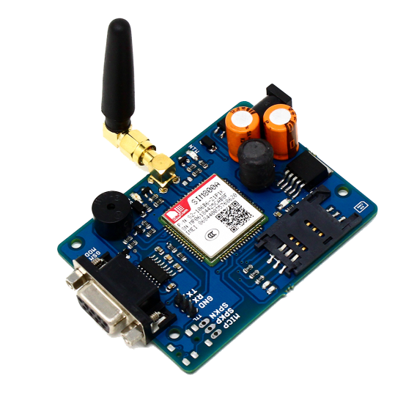
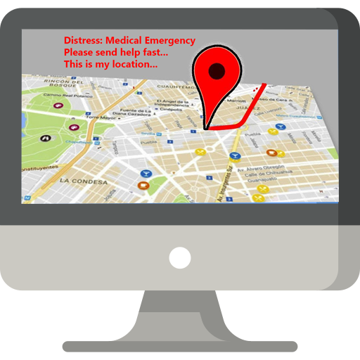
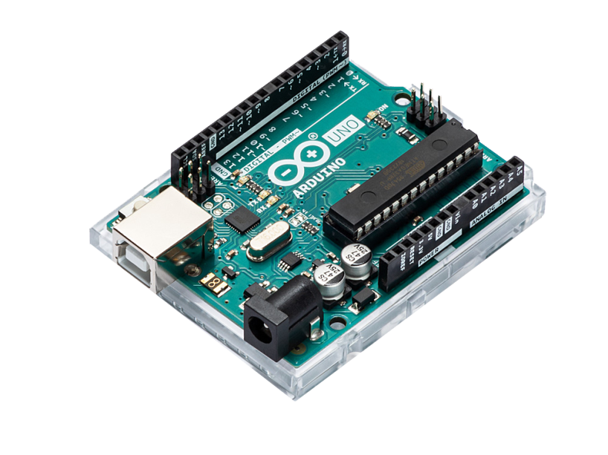
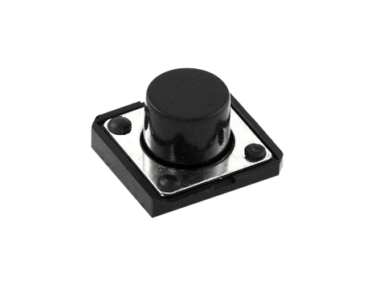
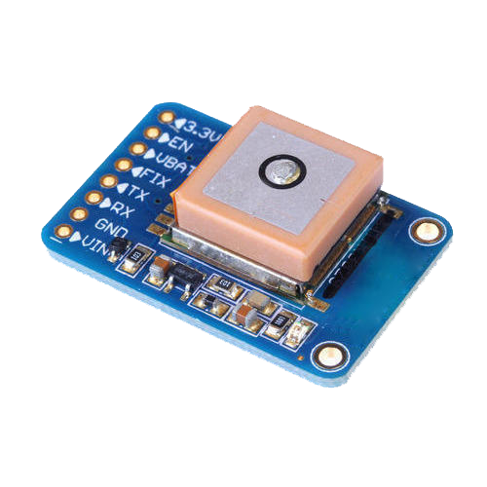
SYSTEM ARCHITECTURE
Message is sent
GSM Module
Push Button
Hospital Server
Arduino UNO Microcontroller
GPS Module

Slide 7
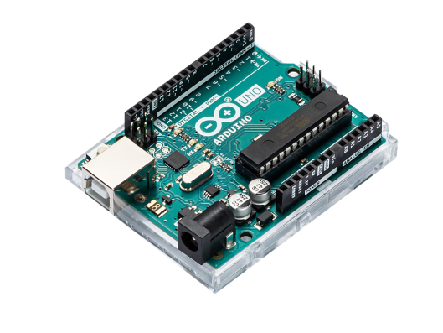

TECHNOLOGY
Arduino UNO microcontroller interacts with GPS and GSM module and gives the appropriate instructions when the button is pushed.
GSM module with sim card transmits the distress signal with GPS co-ordinates to the hospital servers.
GPS module pinpoints the device’s location.

Slide 8
GSM MODULE – SUPPLIED BY 12V 1A EXTERNAL BATTERY ARDINUO BOARD HAS A BULIT IN VOLTAGE REGULATOR GPS MODULE IS A LOW CURRENT DEVICE ARDINUO IS CONNECTED TO THE LAPTOP GPS MODULE CAN BE POWERED DIRECTLY BY THE LAPTOP THROUGH THE ARDINUO
POWER SUPPLY::

Slide 9
FUNCTIONS:
GPS MODULE: TO GIVE THE CO-ORDINATES
GMS MODULE: TO SEND AN EMERGENCY MESSAGE AND IT IS USED
TO BE THE COMMUNICATION INTERFACE USING
SIM CARD

Slide 10
_{QUESTIONS?}

